Slide 1
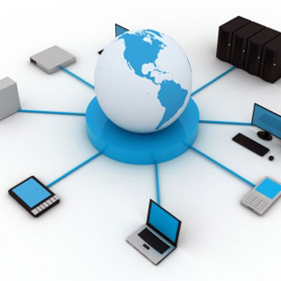
The World Wide Web
Origins and Its Importance

Slide 2
Definition
In abstract sense, the Web is merely a vast collection of documents, some of which are connected by links.
These documents are accessed by Web browsers.
The World Wide Web (WWW, W3) is an information system of interlinked hypertext documents that are accessed via the Internet.

Slide 3
Origins
In 1989, a small group led by Tim Berners-Lee at CERN (European Laboratory for Particle Physics) proposed a new protocol for the Internet as well as a system of documents access to use it.
Intention of this system was to allow scientists around the world to use the Internet to exchange documents describing their work.
The group named this system as the World Wide Web.

Slide 4
Design
This system was designed to allow a user anywhere on the Internet to search for and retrieve documents from databases on any number of document-serving computers.
By late 1990, the system was fully developed and implemented on a NeXT computer at CERN
In 1991, the system was ported to other computer platforms and released to the rest of the world.

Slide 5
Format of Documents in WWW
The documents presented in WWW used hypertext which is text with embedded links to text in other documents (or same) to allow nonsequential browsing of textual material and others.
The World Wide Web is also called simply as the WEB.

Slide 6
Units of information on the WEB
There are several names given for the units of information on the Web.
Some of them are
Documents
Pages
Resources
Documents if named implies only text info
Pages if used will be misleading in that often the WEB have more than one kind of pages that make up printed media
Resources if named maybe merited as that covers the possibility of non-textual information.
Here we will refer more to them as documents and pages
When a document contains non-textual information, it is called hypermedia

Slide 7
Web Browsers
A web browser (commonly referred to as a browser) is a software application for retrieving, presenting and traversing information resources on the World Wide Web or Web
Documents provided and available on the Web are requested by browsers or web browsers which are programs running on client machines.
They are called browsers as they allow the user to browse resources available on the Web.
The first browsers are text-based
Called Lynx browser
This however constrained the growth of Web use.
In 1993, MOSAIC, the first GUI based web browser was released.
Developed at National Center for Supercomputer Applications (NCSA) at University of Illinois
First release of MOSAIC ran on UNIX systems.
By Late 1993, versions of MOSAIC are released for Apple Macintosh and Windows platform.
Most commonly browsers now are
IE (internet explorer)
Firefor Mozilla
Google Chrome
Opera

